Slide 1


Slide 2
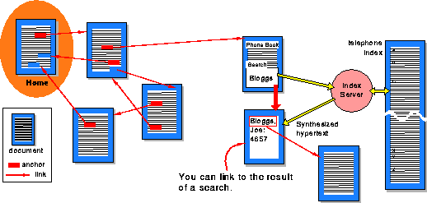
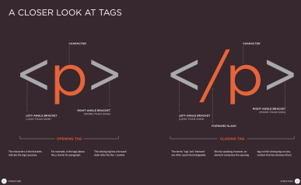
What is HTML is?
HTML is the standard markup language for creating Web pages.
Hypertext Markup Language
Create by Madhusha Prasad.

Slide 3
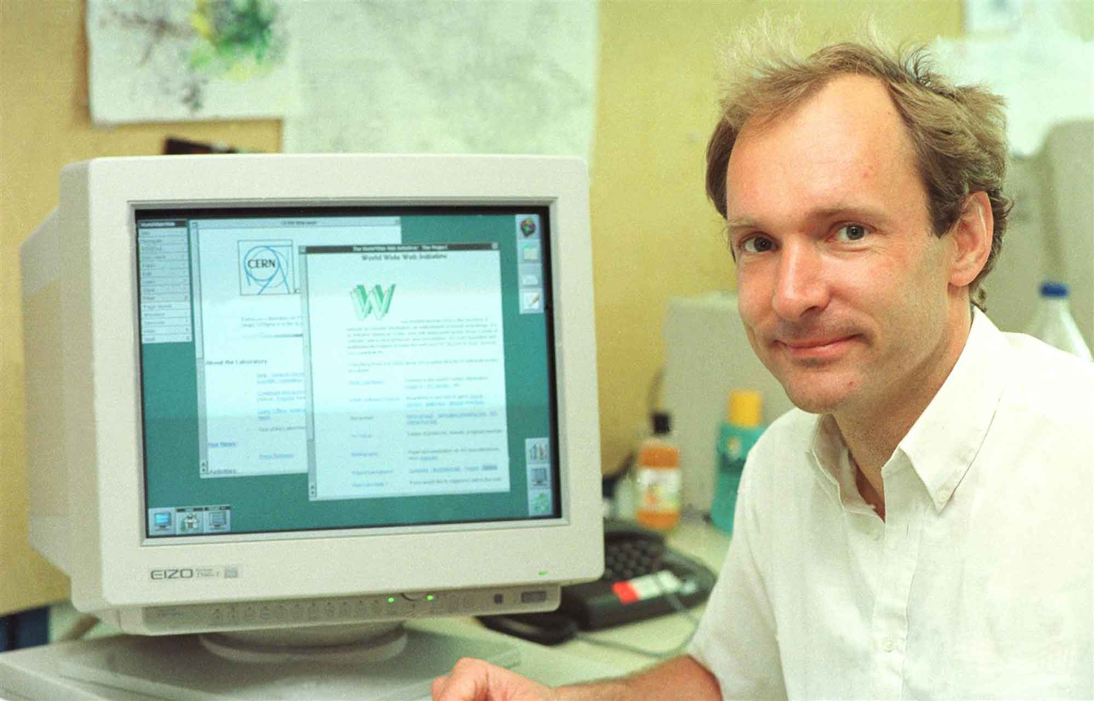
Who Invented HTML and What for ?
HTML was created by Tim Berners-Lee in 1991.
First appeared in 1980 as a system for CERN researchers to use and share documents.
The first-ever version of HTML was HTML 1.0,
but the first standard version was HTML 2.0, published in 1999.
In 1990 he specified HTML and wrote the browser and server software further.
Hypertext Transfer Protocol(HTTP).
The Hypertext Markup Language (HTML),
First Web Browser (WWW)
First HTTP server software
First web server,
The first web page
Sir Timothy John Berners-Lee
contractor at the European Organization for Nuclear Research (CERN)
Create by Madhusha Prasad.

Slide 4

What is HTML?
HTML (Hypertext Markup Language) is not a programming language;
it is a markup language used to tell your browser how to structure the web pages you visit.
It can be as complicated or as simple as the web developer wishes it to be.
HTML consists of a series of elements, which you use to enclose, wrap, or mark up different parts
of the content to make it appear or act a certain way. The enclosing tags can make a bit of content into
a hyperlink to link to another page on the web, italicize words, and so on. For example, take the following
line of content:
<p>This is a Paragraph in html definition</p>

Slide 5
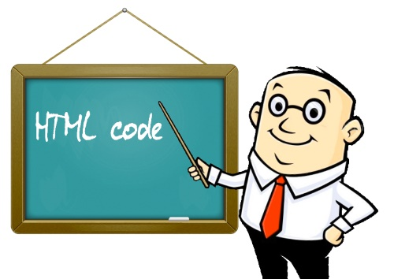
Why learn HTML?
It is a simple markup language. Its implementation is easy.
It is used to create a website.
Helps in developing fundamentals about web programming.
Boost professional career.
Advantages.!
HTML is used to build websites.
It is supported by all browsers.
It can be integrated with other languages like CSS, JavaScript, etc.
Disadvantages.!
HTML can only create static webpages. For dynamic webpages, other languages have to be used.
A large amount of code has to be written to create a simple web page.
The security feature is not good.

Slide 6
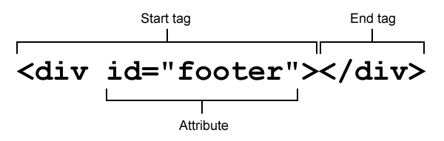
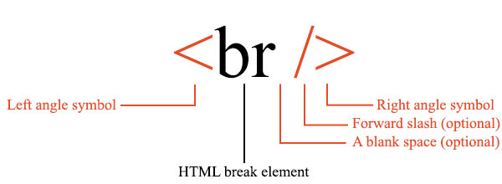
Anatomy of an HTML tag
Html element
Start tag
Attribute – value pair *
Content *
End Tag
*not all elements have these

Slide 7
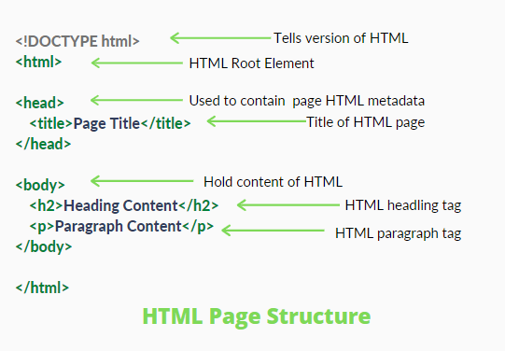
HTML page structure
The basic structure of an HTML page is laid out below.
It contains the essential building-block elements
(i.e., doctype declaration, HTML, head, title, and body elements) upon which all web pages are created.

Slide 8
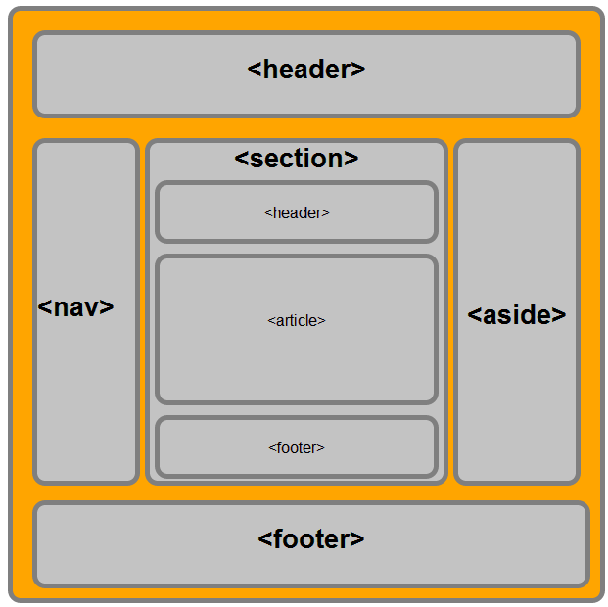
Content sectioning

Slide 9
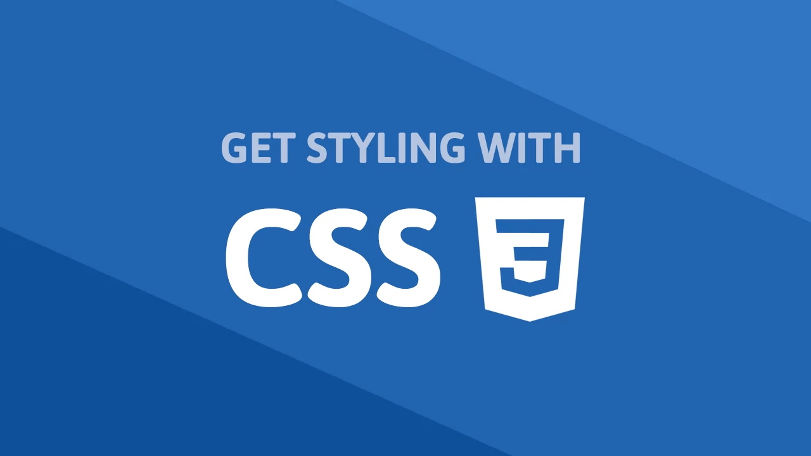

Slide 10

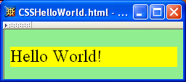
What is css ?
Like HTML, CSS is not a programming language.
CSS is one of three cornerstone technologies used on
the web (the other two are HTML and JavaScript).
CSS stands for Cascading Style Sheets – the clues are really in the
words ‘cascading’ and ‘style’ with cascading describing
the way that one style can cascade from one to another.
CSS stands for Cascading Style Sheets
Styles define how to display HTML elements
Styles are normally stored in Style Sheets
External style sheets can save a lot of work
External style sheets are stored in CSS files
Multiple style definitions will cascade into one

Slide 11

Who invented CSS?
According to Wikipedia, the birth of CSS is largely credited to Norwegian Håkon Wium Lie, who back in 1994 sought to create a universal standardised style sheet for the World Wide Web.
The first site that Lie trialled CSS on was the Arena web browser. From its first creation, Lie went on to co-create CSS1, CSS2 and RFC 2318 versions with Tim Berners-Lee and Robert Cailliau. In its first decade of existence (1994 – 2004) CSS, in all its specifications, became an established web standard greatly influencing the look and accessibility of the world wide web as we know it today. CSS3 was issued in 1999.
Web standards are a topic that are close to Lie’s heart. Since delivering CSS he has petitioned major technology players such as Microsoft and other browsers to support common web standards and continues to develop CSS’s uses for web printing and pagination on screens.

Slide 12
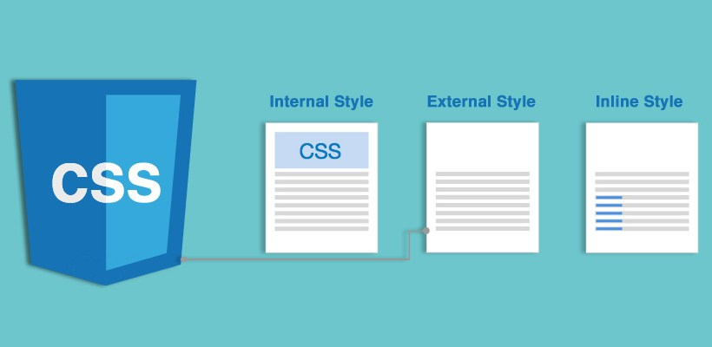
Multiple Ways to Define Style
External Style Sheet (.css files)
Internal Style Sheet
Inline Styles

Slide 13
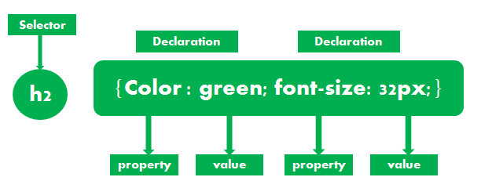
Anatomy of a CSS ruleset
Selector
Declaration
Properties
Property value

Slide 14
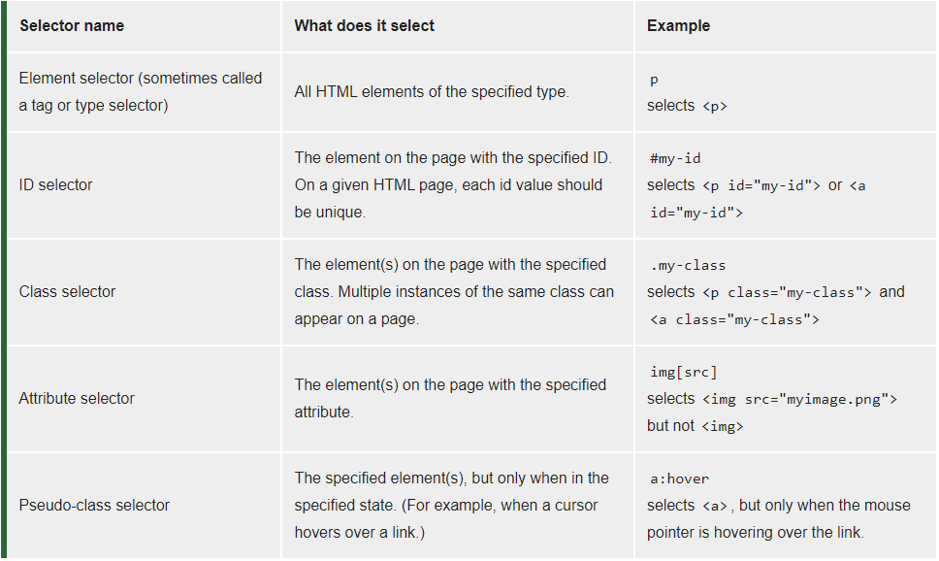
Different types of selectors
Element selector
ID selector
Class selector
Attribute selector
Pseudo-class selector

Slide 15
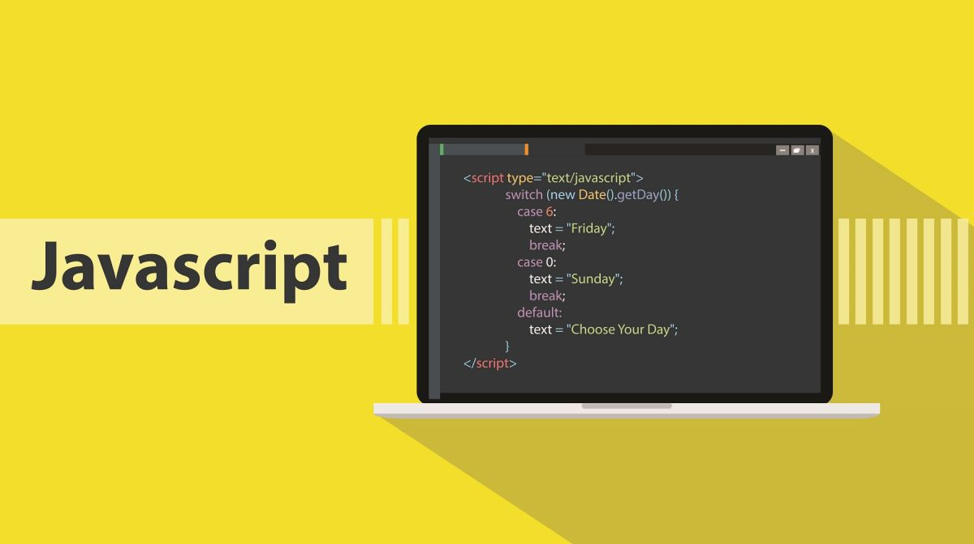

Slide 16
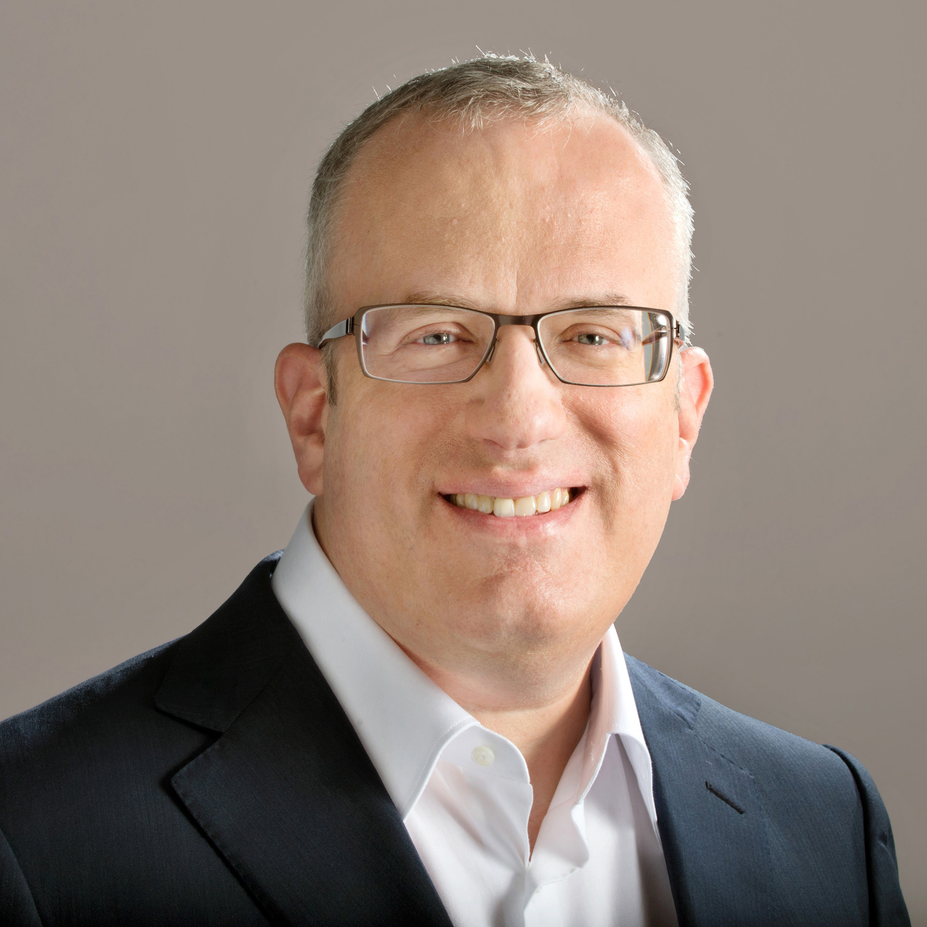
What Is JavaScript?
JavaScript is a scripting language that is one of the three core languages used to develop websites.
HTML and CSS give a website structure and style, JavaScript lets you add functionality and behaviors to your website
JavaScript was invented by Brendan Eich in 1995.

Slide 17


Slide 18
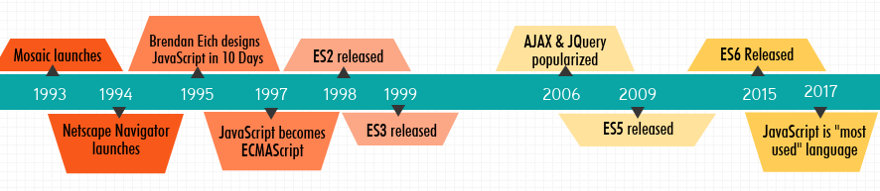
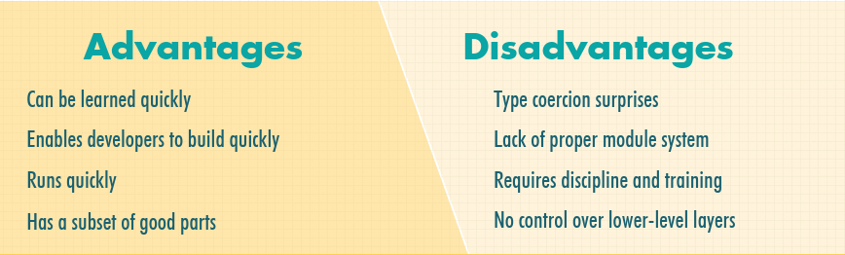

Slide 19

Introduction to the JavaScript
Ways of using JavaScript
1. Internal script
2. External script files

Slide 20
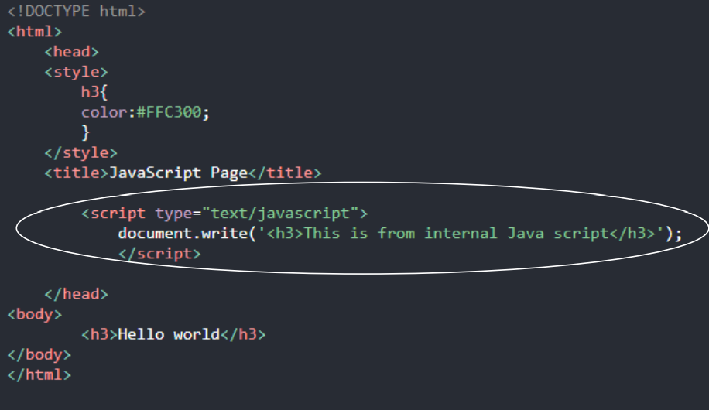
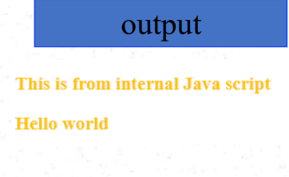
Internal script
Scripts in <body> (inline JS)
Scripts in <head> (Internal script)
Scripts in both <head> and <body>

Slide 21
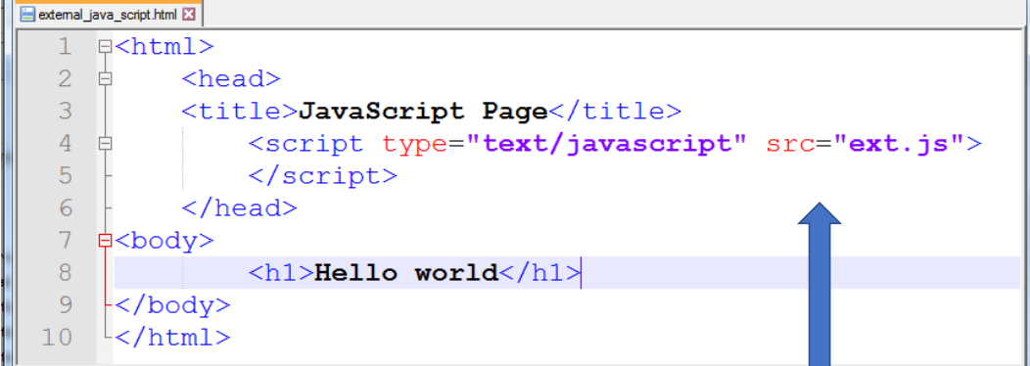
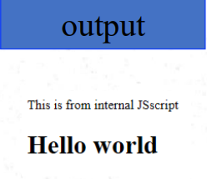
External script files
The JS file should use the extension .js
External file is linked to the web page in head using the script element
The script element uses the src attribute to specify the URL of the source JS file
src=“/.js“

Slide 22
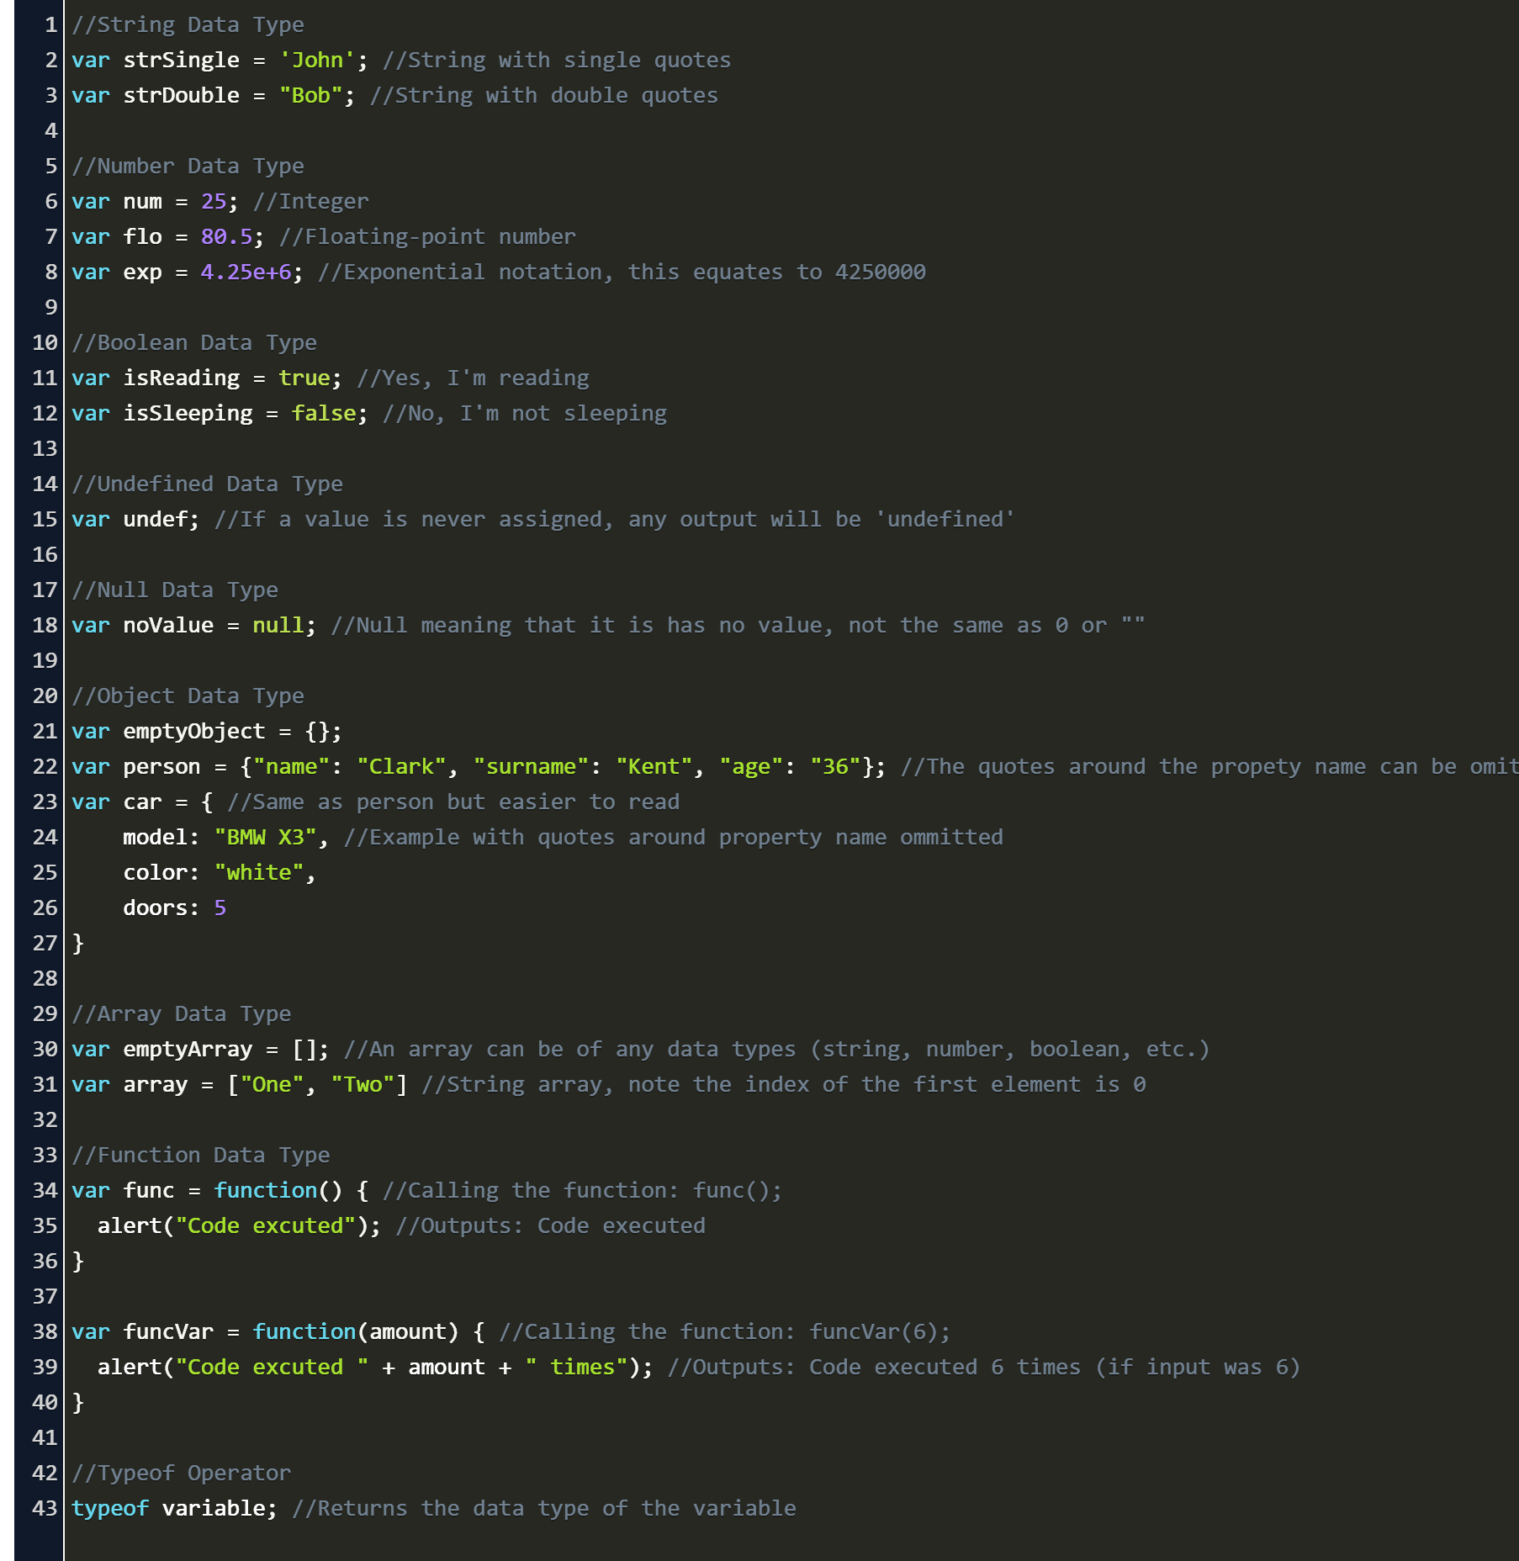
Variables Types in JS
Numerical
Integers –1, 2, 3, -56, -135, 3464
Floating point/Decimal –34.46, -65.135
Strings
Single characters –“a”, “b”, “c”, “2”, “7”
Multiple characters –“abc”, “12/04/2012”, “34”
Boolean –true / false
Null
Undefined
Object

Slide 23
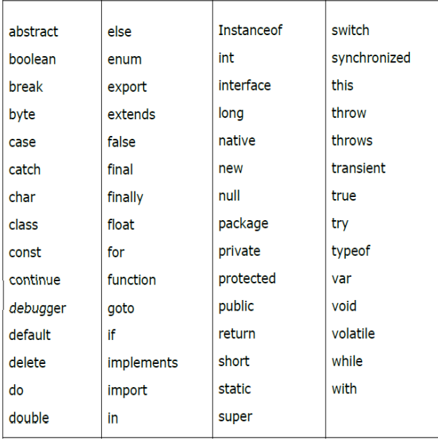
Variable declaration
You should not use any of the JavaScript reserved keywords as a
variable name.
• No spaces
• Meaningful
• Use camel case
• The keyword var and let is used to
declare a variable.

Slide 24
Identify the data type of each variable
• Examples
• var age;
• var smallNumber;
• var initial
• var name
• var isPassed;
• var num1, num2, num3;

Slide 25
Using let and const
const - keyword to define a variable that cannot be reassigned.
let - keyword to define a variable that cannot be reassigned with restricted scope.
Initialize the variables
Assign values to the variables
var age = 20;
var height = 5.5;
var initial = "K";
var name = "Kamal";
var isPassed = true;
age = 20;
height = 5.5;
initial = "K";
name = "Kamal";
isPassed = true;

Slide 26
Operators in JS
1.Arithmetic Operators
2.Assignment Operators
3.Comparison Operators
4.Logical Operators

Slide 27
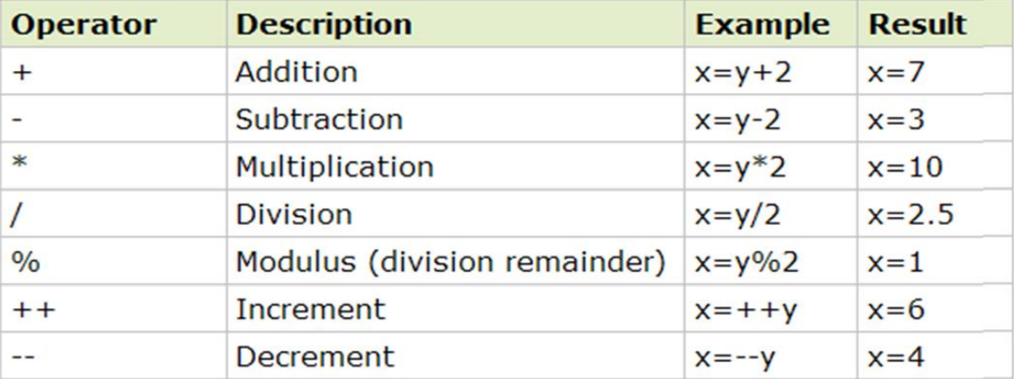
Operators in JS Arithmetic Operators

Slide 28
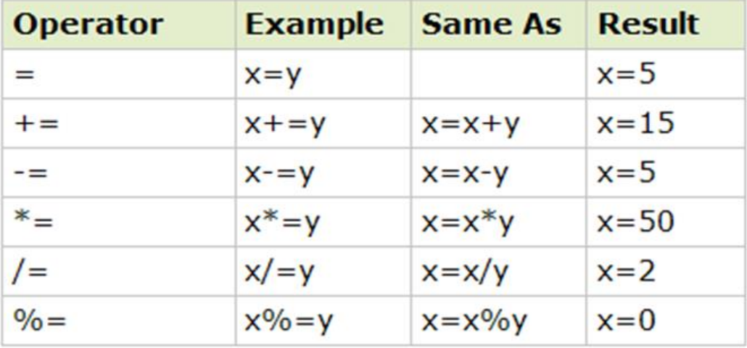
Operators in JS Assignment Operators

Slide 29
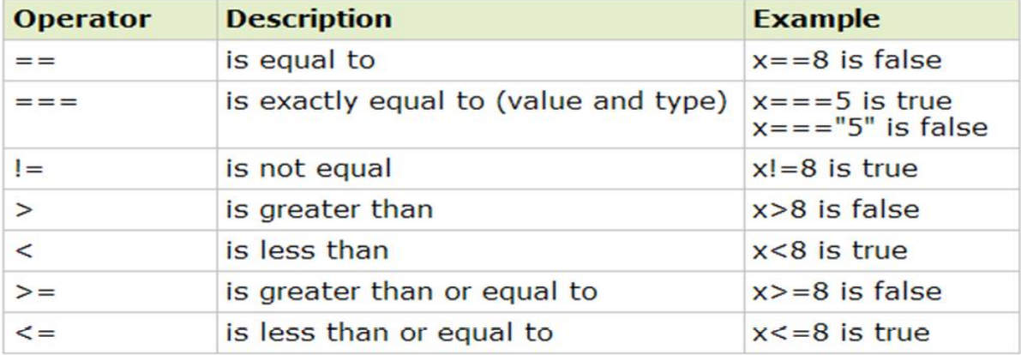
Operators in JS Comparison Operators

Slide 30
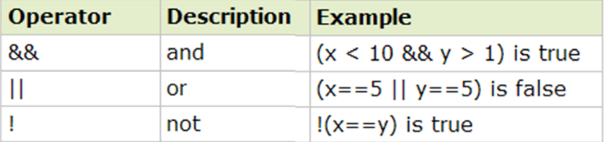
Operators in JS Logical Operators

Slide 31
Control Structures in JS
1. Sequence
2. Selection / Branching
• Simple if-else
• If-else ladder
• Nested if-else
• switch
3. Repetition / Iteration / Looping
• While loop
• For loop

Slide 32
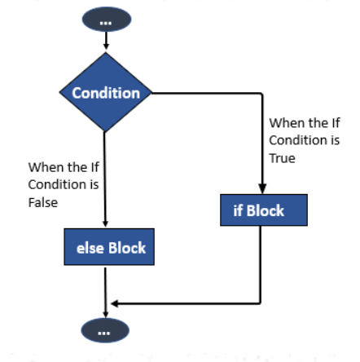
Simple if-else
if (<Condition>)
{
//Do something
}
Else
{
//Do some other thing
}
Else is optional
if(mark >= 50)
{
document.write ("Pass");
}
Else
{
document.write ("Fail");
}

Slide 33
Nested if-else
If(<condition 1>)
{
if (<condition 2>) { //Actions }
else { //Actions }
}
Else
{
if (<condition 3>) { //Actions }
else { //Actions }
}

Slide 34
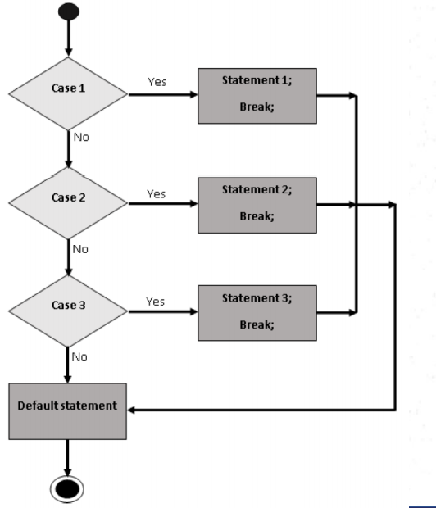
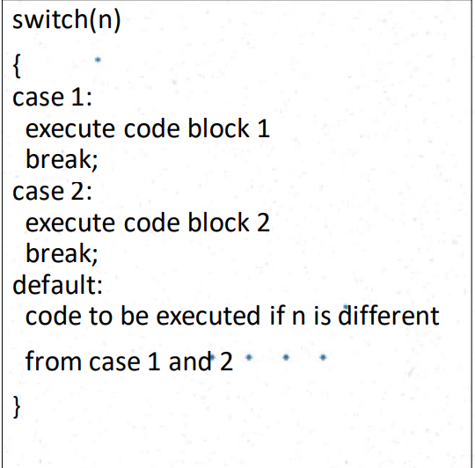
Switch

Slide 35
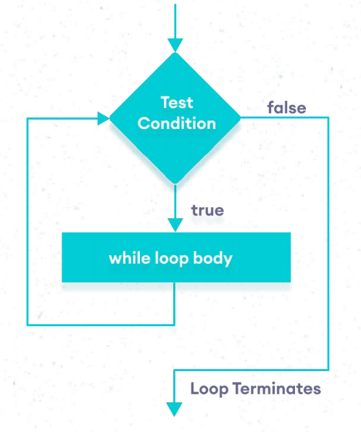
Loops – while loop
• The purpose of a while loop is to execute a statement or code block repeatedly if an expression is true.
• Once the expression becomes false, the loop terminates.

Slide 36
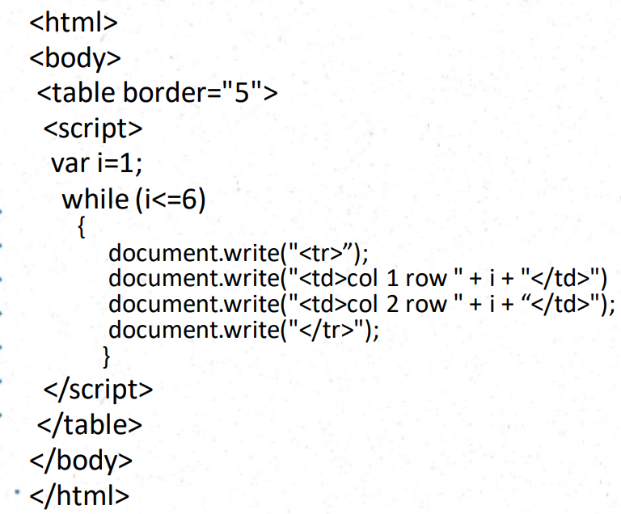
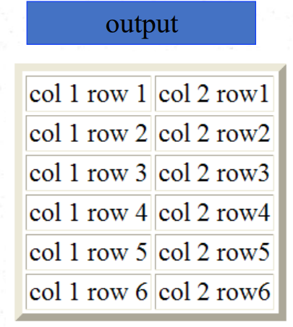
Loops – while loop

Slide 37
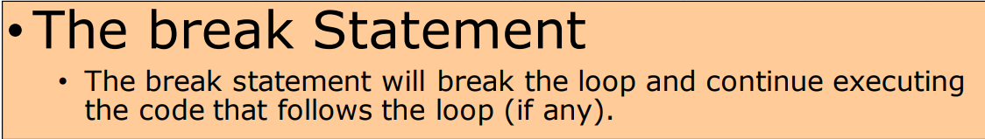
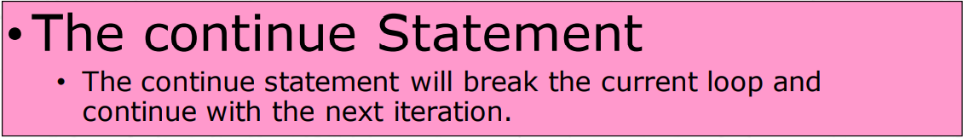
Break Statement and Continue Statement
The break statement is used to terminate the loop immediately.
The continue statement is used to skip the current iteration of the loop.

Slide 38
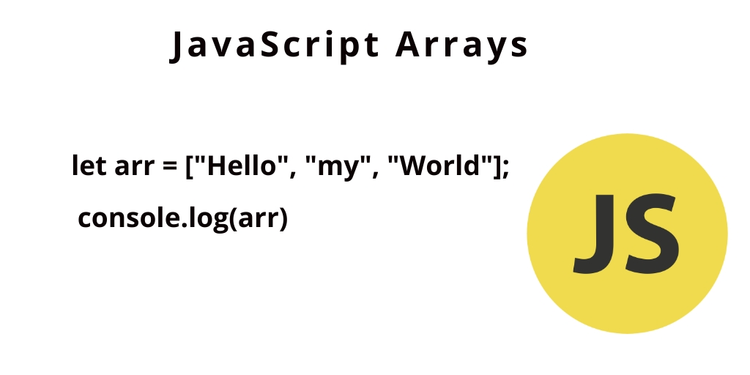
JavaScript Arrays
An array is a special variable, which can hold more than one value at a time.
var array_name = [item1,item2, ...];
var cars = [“Toyota”, “Volvo”];
How to insert new elements
Cars[2]=“BMW”;
How to display element ant it’s value
Document.write(Cars[0]);

Slide 39
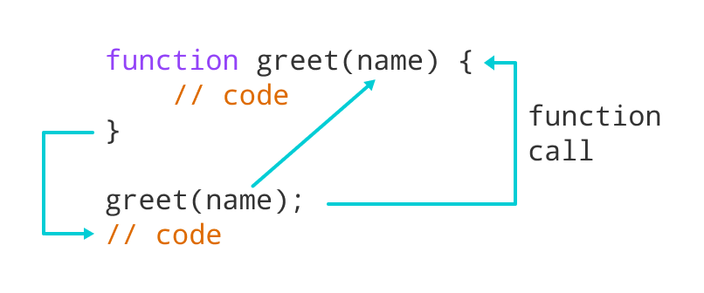
JavaScript Functions
A function is a group of reusable code which can be called anywhere in your program.
This eliminates the need of writing the same code again and again.
It helps programmers in writing modular codes.
Functions allow a programmer to divide a big program into several small and manageable functions.

Slide 40
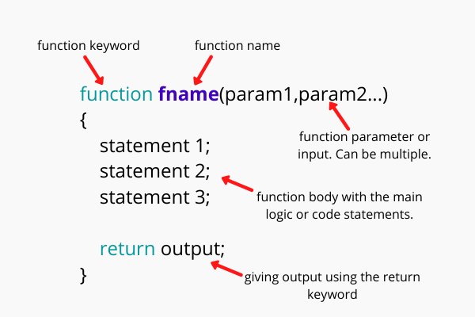
JavaScript Functions Definition
Before we use a function, we need to define it.
The most common way to define a function in JavaScript is by using the function keyword, followed.

Slide 41
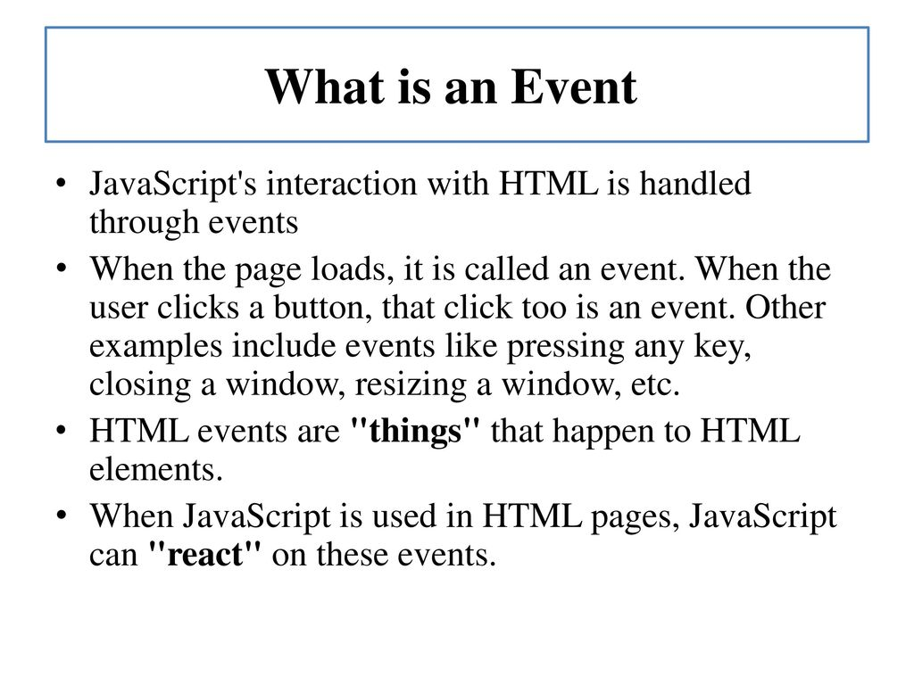
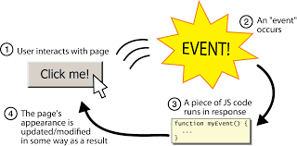
JavaScript Event Handling

Slide 42
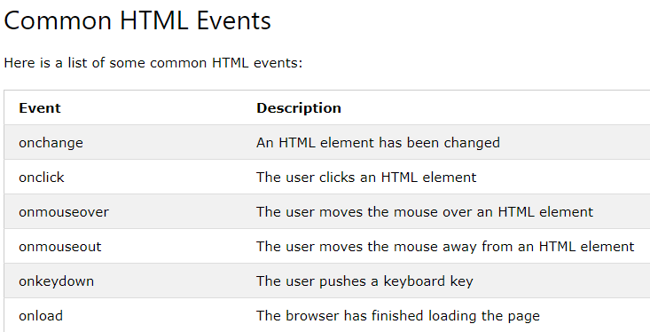
JavaScript Event Handling

Slide 43

PHP: Hypertext Preprocessor
Create by Madhusha Prasad.

Slide 44

What is php?
PHP is a recursive acronym for "PHP: Hypertext Preprocessor“.
Php is one of the most popular, open source, server-side, scripting language meant for developing web application.
1994: Created by Rasmus Lerdorf, software engineer (part of Apache Team).
1995: Called Personal Home Page Tool, then released as version 2 with name PHP/FI (Form Interpreter, to analyze SQL queries).
Create by Madhusha Prasad.

Slide 45
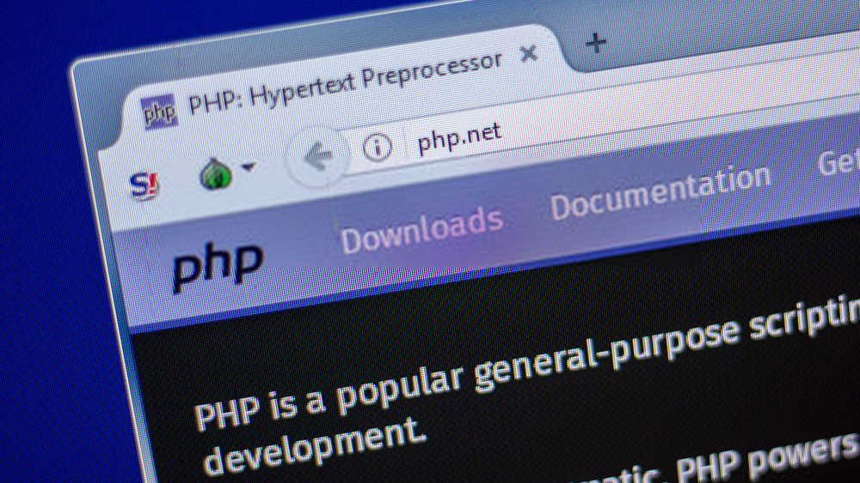
(Good) Topics about PHP
Open-source
Easy to use ( C-like and Perl-like syntax)
Stable and fast
Multiplatform
Many databases support
Many common built-in libraries
Pre-installed in Linux distributions
Create by Madhusha Prasad.

Slide 46
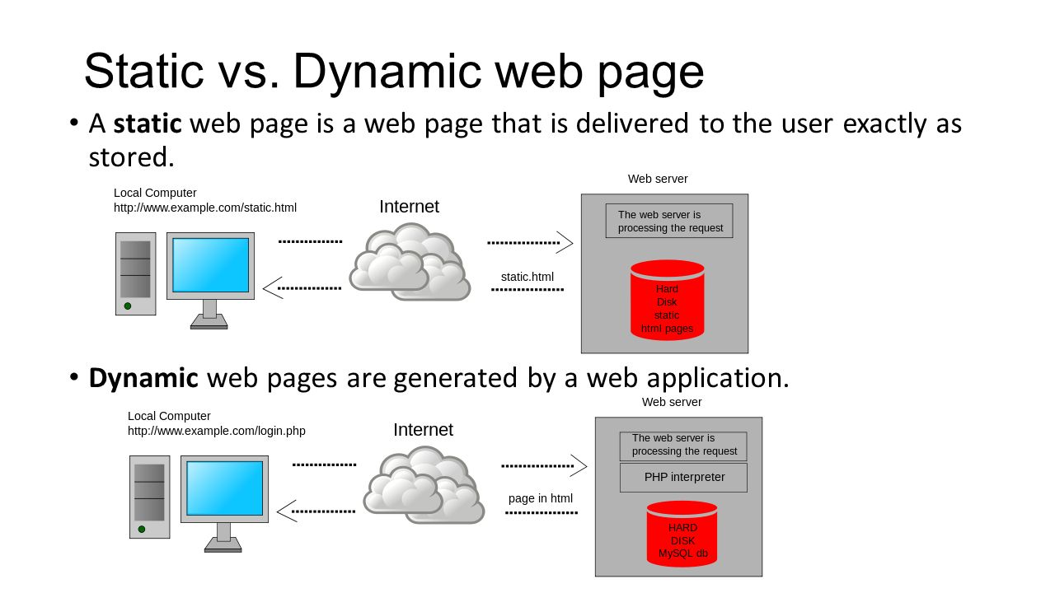
What Can PHP Do?
Generating dynamic page content.
Creating, opening, reading, writing, deleting, and closing files on the server.
Collecting form data.
Adding, deleting, and modifying information stored in your database.
controlling user-access.
encrypting data.
Send and Receive cookies and much more.
Create by Madhusha Prasad.

Slide 47
How PHP generates HTML/JS Web pages
Client Browser
1
4
3
PHP module
Apache
2
1: Client from browser send HTTP request (with POST/GET variables)
2: Apache recognizes that a PHP script is requested and sends the request to PHP module
3: PHP interpreter executes PHP script, collects script output and sends it back
4: Apache replies to client using the PHP script output as HTML output
Create by Madhusha Prasad.

Slide 48
PHP Code Hello World! (web oriented)
The file/page with PHP script is saved to .php extension. (.php)
The script/code is written between the PHP tag. (<?php ?>)
<?php
echo “<h1>Hello world</h1>”;
// The output may contain HTML
?>
PHP code can be written
1. Inline with HTML //Not recommended
2. On the top of the file //Like internal CSS sheets JavaScripts
3. As an external file//Like external CSS sheets JavaScripts
Create by Madhusha Prasad.

Slide 49
Inline with HTML //Not recommended
<html>
<head></head>
<body>
<h1>PHP example</h1>
Output :
PHP example
Hello World
<?php
echo “<h1>Hello world</h1>”;
?>
</body>
</html>
Create by Madhusha Prasad.

Slide 50
On the top of the file //Like internal CSS sheets JavaScripts
Output :
<?php
echo “<h1>Hello world</h1>”;
?>
Hello World
PHP example
<html>
<head></head>
<body>
<h1>PHP example</h1>
</body>
</html>
Create by Madhusha Prasad.

Slide 51
As an external file//Like external CSS sheets JavaScripts
Output :
PHP example
<html>
<head></head>
<body>
<h1>PHP example</h1>
Hello World
Logic.php
</body>
</html>
<?php
echo “<h1>Hello world</h1>”;
?>
Create by Madhusha Prasad.

Slide 52
Varibales
Must not start with a number or special characters ' < & , > ^
Must not contain spaces.
Must be less than 32 characters
$3_name –incorrect
$name_ –correct
$name it –incorrect
$name –correct
To use or assign variable $ must be present before the name of the variable
The assign operator is '='
There is no need to declare the type of the variable
the current stored value produces an implicit type-casting of the variable.
A variable can be used before to be assigned
$A = 1;
$B = “2”;
$C = ($A + $B); // Integer sum
$D = $A . $B; // String concatenation
echo $C; // prints 3
echo $D;// prints 12
Create by Madhusha Prasad.

Slide 53
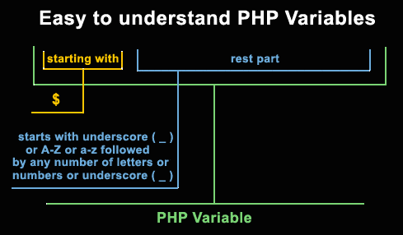
Varibales
All user-defined functions, classes, and keywords are NOT case-sensitive.
All variables are case-sensitive.
Double quotes (") will replace a variable’s name with its value.
$a=5;
echo “$a”; //Will display 5
Single quotes (') will treat them literally (display exactly what you type).
$a=5;
echo ‘$a’; //Will display $a
Create by Madhusha Prasad.

Slide 54
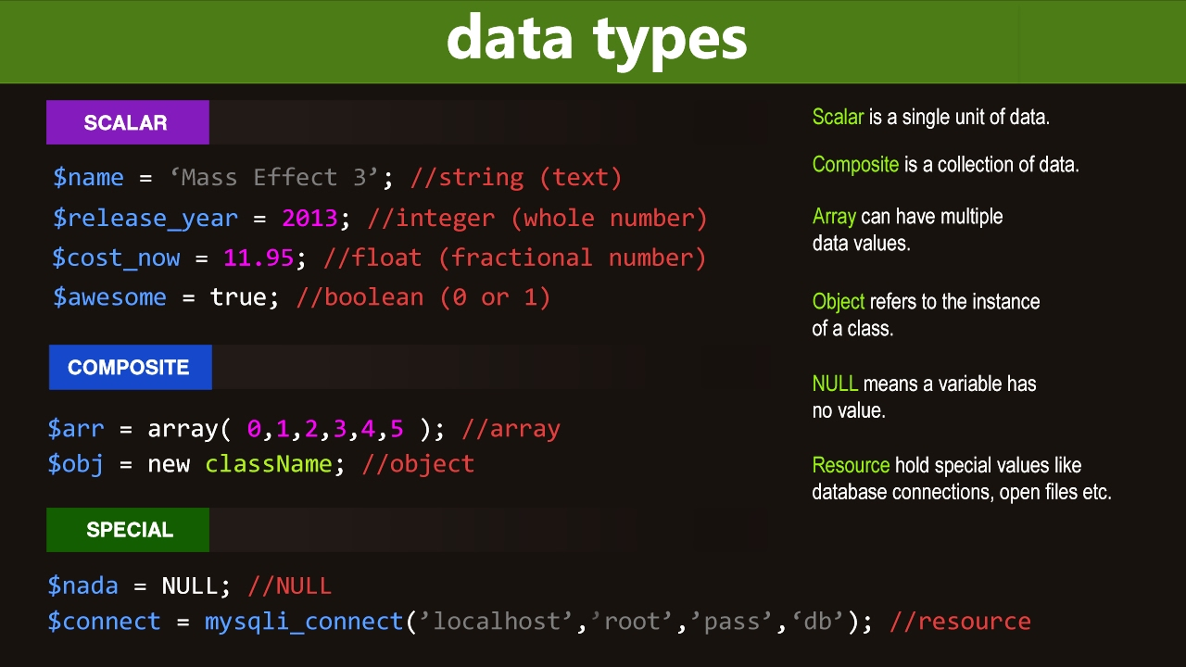
Data Types
PHP is weakly types language
string $myString = "Hello world";
integers $myNumber = 21;
floating-point /double $myNumber = 21.4;
boolean$gameOver = false;
Create by Madhusha Prasad.

Slide 55
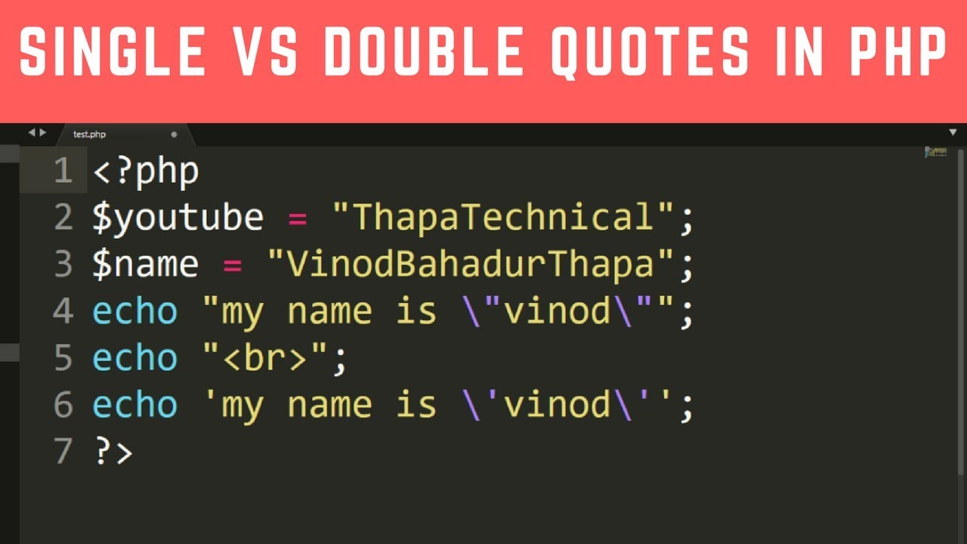
Double-quoted and Single-quoted strings
Double quotes can be used within single-quoted strings and vice versa.
Both valid:
$phrase = "It's time to go";
$phrase = 'She said “OK”‘;
The following are not valid (error due to mismatch of quotes):
$phrase = 'It's time to go’;
$phrase = “She said “OK“ “;
If you want to use the same quote within a quoted string you must escape it by using a backslash.
$phrase = 'It\'s time to go';
$phrase = "He said \"OK\“ ";
Create by Madhusha Prasad.

Slide 56
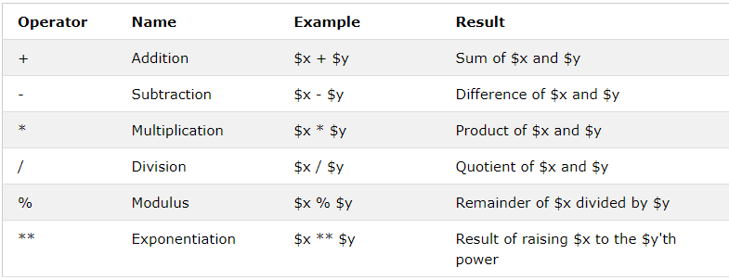
Operators – Arithmetic Operators
The PHP arithmetic operators are used with numeric values to perform common arithmetical operations, such as addition, subtraction, multiplication etc.
Create by Madhusha Prasad.

Slide 57
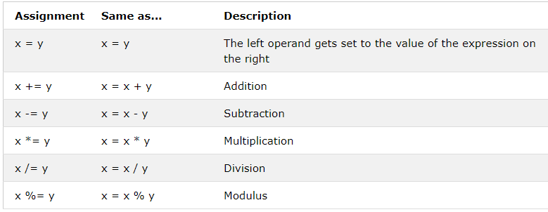
Operators – Assignment Operators
The PHP assignment operators are used with numeric values to write a value to a variable.
The basic assignment operator in PHP is "=". It means that the left operand gets set to the value of the assignment expression on the right.
Create by Madhusha Prasad.

Slide 58
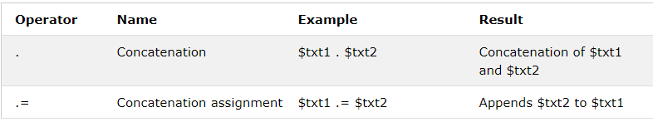
Operators – String Operators
PHP has two operators that are specially designed for strings.
Operators – Comparison Operators
The PHP comparison operators are used to compare two values (number or string):
Create by Madhusha Prasad.

Slide 59
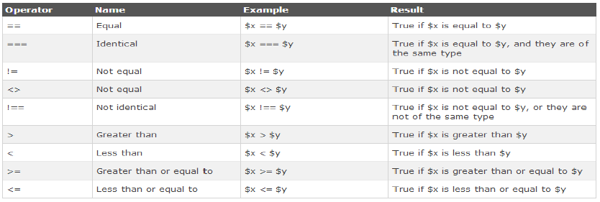
Create by Madhusha Prasad.

Slide 60

Operators – Logical Operators
The PHP logical operators are used to combine conditional statements.
Create by Madhusha Prasad.

Slide 61

Operators – Array Operators
The PHP array operators are used to compare arrays.
Create by Madhusha Prasad.

Slide 62
Control Structures
What is a control structure?
In simple terms, a control structure allows you to control the flow of code execution in your application.
Control structures are core features of the PHP language that allow your script to respond differently to different inputs or situations. This could allow your script to give different responses based on user input, file contents, or some other data.
PHP supports several different control structures:
If – else
switch
while
do while
for
foreach
continue and break
Create by Madhusha Prasad.

Slide 63

If else ladder
If… then... else is the simplest control structure. It evaluates the conditions using Boolean logic When to use if… then… else
“if (condition is true)” is the control structure
“block one” is the code to be executed if the condition is true
{…else…} is the fallback if the condition is false
“block two” is the block of code executed if the condition is false
Create by Madhusha Prasad.

Slide 64

switch
Switch… case is like the if then… else control structure. It only executes a single block of code depending on the value of the condition.
“switch(…){…}” is the control structure block code
“case value: case…” are the blocks of code to be executed depending on the value of the condition
“default:” is the block of code to be executed when no value matches with the condition
Create by Madhusha Prasad.

Slide 65

while
They are used to execute a block of code a repeatedly until the set condition gets satisfied
While loops are used to execute a block of code until a certain condition becomes true.
You can use a while loop to read records returned from a database query.
“while(…){…}” is the while loop block code
“condition” is the condition to be evaluated by the while loop
“block of code…” is the code to be executed if the condition gets satisfied
Create by Madhusha Prasad.

Slide 66

do while
do… while is executed at-least once before the condition is evaluated.
“do{…} while(…)” is the do… while loop block code
“condition” is the condition to be evaluated by the while loop
“block of code…” is the code that is executed at least once by the do… while loop
Create by Madhusha Prasad.

Slide 67

for
A Loop is an Iterative Control Structure that involves executing the same number of code several times until a certain condition is met.
“for…{…}” is the loop block
“initialize” usually an integer; it is used to set the counter’s initial value.
“condition” the condition that is evaluated for each php execution. If it evaluates to true, then execution of the for... loop is terminated. If it evaluates to false, the execution of the for... loop continues.
“increment” is used to increment the initial value of counter integer.
Create by Madhusha Prasad.

Slide 68
foreach
The php foreach loop is used to iterate through array values. It has the following basic syntax
“foreach(…){…}” is the foreach php loop block code
“$array_data” is the array variable to be looped through
“$array_value “ is the temporary variable that holds the current array item values.
“block of code…” is the piece of code that operates on the array values
Create by Madhusha Prasad.

Slide 69
Continue and Break
continue
The continue statement breaks one iteration (in the loop), if a specified condition occurs, and continues with the next iteration in the loop.
This example skips the value of 4:
<?php for ($x = 0; $x < 10; $x++) { if ($x == 4) { continue; } echo "The number is: $x <br>"; } ?>
Create by Madhusha Prasad.

Slide 70

Continue and Break
break
You have already seen the break statement used in an earlier slide of this presentation. It was used to "jump out" of a switch statement.
break statement can also be used to jump out of a loop.
<?php for ($x = 0; $x < 10; $x++) { if ($x == 4) { break; } echo "The number is: $x <br>"; } ?>
Create by Madhusha Prasad.

Slide 71

Superglobal variables
There are some built-in variables in PHP environment, which provides some special features, they are called superglobal variables.
They are basically associative arrays.
Create by Madhusha Prasad.

Slide 72
Superglobal variables
$GLOBALS - $GLOBALS is a PHP super global variable which is used to access global variables from anywhere in the PHP script (also from within functions or methods).
$_SERVER - $_SERVER is a PHP super global variable which holds information about headers, paths, and script locations.
$_REQUEST - PHP $_REQUEST is a PHP super global variable which is used to collect data after submitting an HTML form.
$_POST - PHP $_POST is a PHP super global variable which is used to collect form data after submitting an HTML form with method="post". $_POST is also widely used to pass variables.
$_GET - PHP $_GET is a PHP super global variable which is used to collect form data after submitting an HTML form with method="get“.
$_FILES – $_FILES is an associative array containing items uploaded via HTTP POST method.
$_ENV - $_ENV is another superglobal associative array in PHP. It stores environment variables available to current script.
$_COOKIE - A cookie is often used to identify a user., A cookie is a small file that the server embeds on the user's computer.
$_SESSION - A session is a way to store information (in variables) to be used across multiple pages.
Create by Madhusha Prasad.

Slide 73

Database handling
What is database?
Databaseis an external resource, hosted in a database server, and managed by a DBMS.
The database server is considered as a separate tire.
Create by Madhusha Prasad.

Slide 74

Ways to connect to DB using PHP
What is database?
Create by Madhusha Prasad.

Slide 75
Connection Configurations
It is a good idea to keep the DB configurations in a dedicated file config.php
//The connection object
//$con= new mysqli(“Server”, “UN”, “PW”, “DB”);
<?php $mysqli = new mysqli("localhost","my_user","my_password","my_db"); // Check connection if ($mysqli -> connect_errno) { echo "Failed to connect to MySQL: " . $mysqli -> connect_error; exit(); } ?>
Create by Madhusha Prasad.

